Slide 1
Visual Studio’s Debugger

Slide 2
Why?
Printing out data as you go can be incredibly helpful, but what happens when the data structure you are trying to debug has 1000 elements in it?
The debugger allows you to see what your code is doing, step by step.
If life gives you lemons…

Slide 3

What is F5 vs Ctrl + F5?
Ctrl + F5 : “ProjectName”\bin\Debug\”ProjectName”.exe
Simply runs the binary built from your code.
F5 : Visual Studio runs the program with the debugger attached.
Pause code at specific points with breakpoints.
Step through code line by line.
Inspect all data.

Slide 4
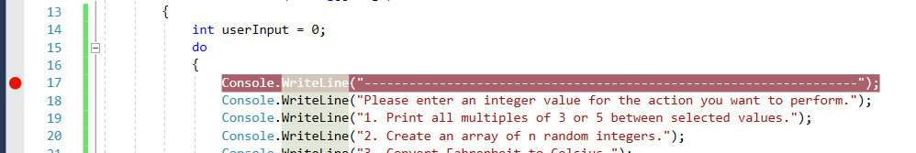
Breakpoints
Click the bar on the far left side of the screen to create one.
When your code reaches this line, it will halt and allow you to see your processes at this exact moment.

Slide 5

Debugging Functions
Continue - F5
Pause
Stop - Shift F5
Step into - F11
Step over - F10
Step out - Shift + F11

Slide 6
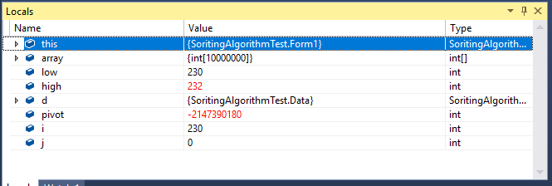
Locals Tab
At any given point in my code I can see values of all in-scope variables.
NOTE: This is not every available variable in the software.

Slide 7
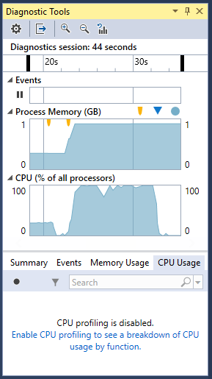
Diagnostic Tools
Shows things like:
How your computer is working.
Memory usage
CPU usage
Events List
Debugging events
Useful when optimizing code.
My merge sort uses close to 100% of my CPU. This is a good thing!
My array is almost 1gb of ram. This is not a good thing!

Slide 8
Demo Sorting Project

Slide 9
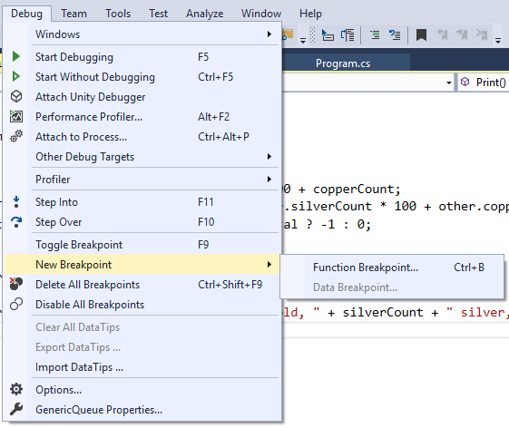
Useful Tips
Sometimes, you don’t want your code to stop every few milliseconds.
You can either delete all breakpoints, or disable them.

Slide 10
Lab
Not for a grade
Download “Debugging.zip” from Canvas
Every method has numerous runtime and logical errors.
Fix the method until it does what it says it should do.
Feel free to work with partners/neighbors.

